Slide 1
Graphical User Interface
Section 1
Chapter 8
© 2016 Pearson Education, Ltd. All rights reserved.

Slide 2
Widgets
Widgets are the components of a graphical user interface.
  In this section we discuss the capabilities of five widgets.
In the next two sections we show how to position widgets in a window and how to write programs that manipulate the widgets.
Widgets are objects, and their classes are defined in a module named tkinter

Slide 3
What is a Graphical User Interface?
The programs in previous chapters are said to have a text-based user interface (TUI).
A graphical user interface, or GUI, presents the user with a window containing visual objects;
  such as boxes where the user can type in data,
  and buttons that initiate actions.
These visual objects (called widgets) respond to events such as mouse clicks.
  Since events are so central to GUI programs, GUI programs are said to be event driven.

Slide 4
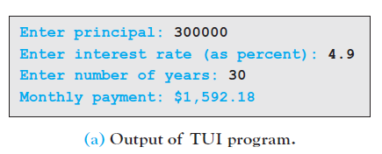
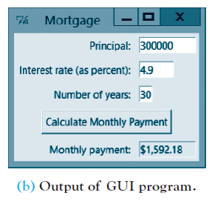
What is a Graphical User Interface?
Figure shows the output of Python programs that calculate the monthly payment for a mortgage. Each program requests three pieces of data and then displays the amount of the monthly payment:
In (b) the three white boxes above the button may be
filled in any order. When the user clicks on a white box
with the mouse, the cursor moves to that box. The user can type information.
When satisfied that all the information is as intended, the user clicks on the Calculate Monthly Payment button to display the amount of the monthly payment in the box below the button. The user can experiment with different input values:
For instance, the user can replace the number 30 with the number 25 and then click on the button to see how much the monthly payment would be for a 25-year mortgage. There is no need for the user to reenter the other two pieces of input.

Slide 5
The Button Widget
The boxes appearing in the GUI window are called Entry widgets
The text displayed to the left of the boxes is contained in Label widgets,
The button is called a Button widget.
Each widget is an object with properties and each widget can respond to events such as mouse movements, key presses, and mouse clicks.
For example, each Entry widget has a width property and each Label widget has a text property.

Slide 6
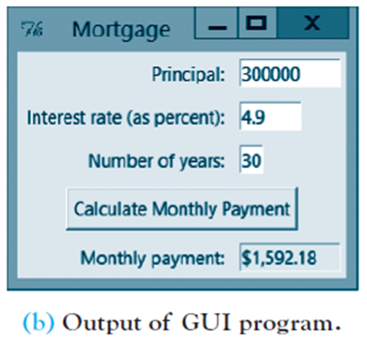
The Button Widget
In (b), the button responds to a mouse click event.
  When the user clicks on the button, the event calls a function that calculates the monthly payment and displays it in the tinted Entry widget in the bottom right corner of the window.
The employment of widgets and events allows the user to decide the order in which things happen by triggering events.

Slide 7
The Button Widget
In this section we will discuss buttons, labels, entry boxes, list boxes, and scroll bars
  and will write short programs that illustrate some of their properties and events.
Each program will begin with the two statements
from tkinter import *
window = Tk()
and end with the statement
window.mainloop()

Slide 8

The Button Widget
The first statement imports the tkinter module
The second statement creates an instance of the Tk class and gives it the name window.
Most GUI programs contain events.
  The mainloop function acts like an infinite loop that keeps looking for events until you close the window by clicking on its Close button at the top of the window.

Slide 9
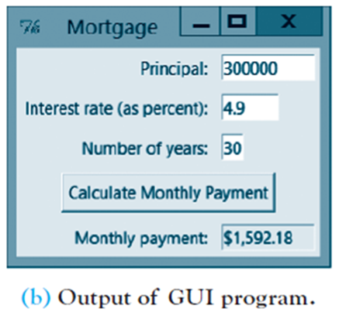
The Button Widget
Depending on the operating system and the way the program is invoked,
  the mainloop function may or may not be needed.
  However, in order to cover all bases, we will always include the function.
Each window has a title property that places text in its title bar.
  For instance, in (b) the word “Mortgage” is placed in the title bar with the statement
window.title("Mortgage")

Slide 10
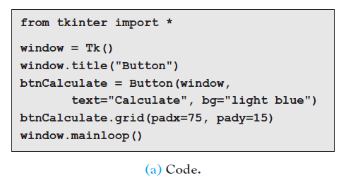
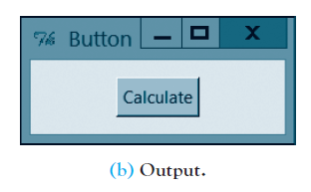
The Button Widget
The code in Fig(a) produces the output in Fig(b), where the color of the button is light blue.

Slide 11
The Button Widget
The fourth statement creates an instance of a Button widget
The fifth statement displays the widget in the window.
  [The grid method controls the placement of widgets on the window, and plays such an essential role in GUI programming that the entire second section of this chapter is devoted to it. For now, we just need to know that the grid method makes the button visible and puts blank space around it.

Slide 12
The Button Widget
The setting for padx specifies how much blank space (in pixels) should be placed to the left and right of the widget
and pady does the same for blank space above and below the widget.
  The left side of the fourth statement is the name chosen for the widget. We like to begin each name with three letters that indicate the type of widget being instantiated. (btnCalculate)

Slide 13
The Button Widget
The right side of the statement (constructor) contains the type of widget followed by several arguments inside a pair of parentheses.
  The first argument is always the name of the widget’s container. (the container will always be named window)
The terms text and bg in the arguments text="Calculate" and bg="light blue" are called attributes.

Slide 14
The Button Widget
The text attribute specifies the caption to be displayed
The optional bg attribute specifies the color of the button. If this attribute is omitted, the button will have the color gray. By default the button will be just wide enough to accommodate its caption.
However, an argument of the form width=n can be inserted to set the width of the button to n characters. By default, the caption is centered in its button. There are several other arguments that can be inserted into the constructor to make additional alterations to the appearance of the button and its caption.

Slide 15
The Button Widget
Run the program in (a) and then left-click on the button with the mouse.
The button appears to be pushed in and then to pop out.
The left-click triggered an event that pushed the button.
  However, the event can do much more than just push the button; it can call a function. Note: To end the program, click on the Close button at the top of the window.

Slide 16
The Button Widget
The program in Example 1 inserts a function named
changeColor
and adds an additional argument into the constructor
(command=changeColor)
The argument command=changeColor causes the left-click event to call the changeColor function.
  (This function is referred to as the callback function associated with the event, or the event handler, and the argument is said to bind the function to the button.)

Slide 17
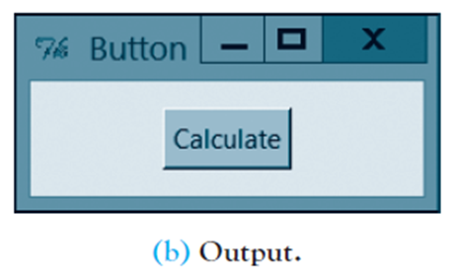
The Button Widget
The value of the expression btnCalculate["fg"] is the color of the caption.
In general, the value of an expression of the form
widgetName["attribute"]
gives the value assigned to the attribute.
For instance, the value of btnCalculate["text"] is the string “Calculate”.

Slide 18
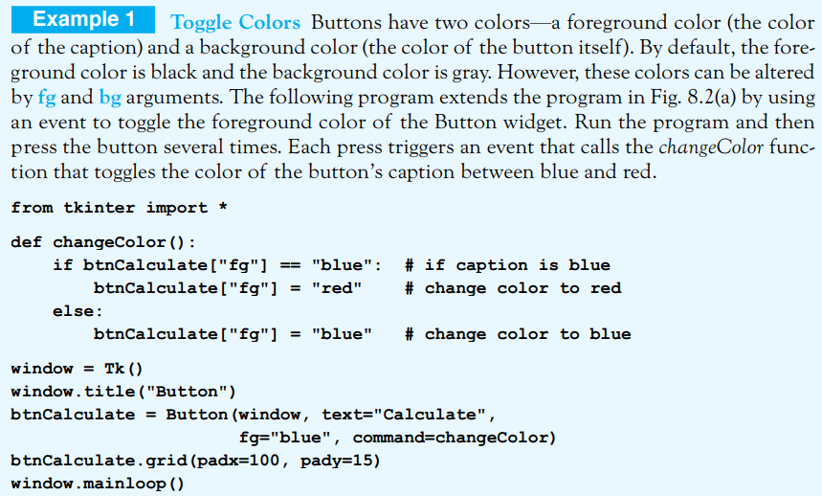
The Button Widget
© 2016 Pearson Education, Ltd. All rights reserved.

Slide 19
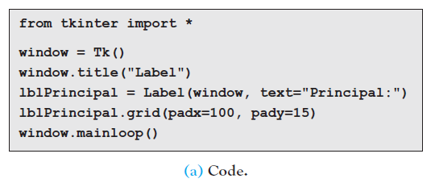
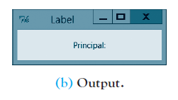
The Label Widget
The Label widget is one of the simplest widgets. In Fig(b), Label widgets were placed to the left of each Entry widget to identify the contents of the boxes.
The code in Fig(a) produces the output in Fig(b).
  Note: By default, all text placed into widgets has the color black. However, the process that converted the multi-colored screen captures to the figures, changed all the black text to blue. Therefore, unless an example or exercise specifically calls for blue text, treat all text in the figures as if it were colored black.

Slide 20
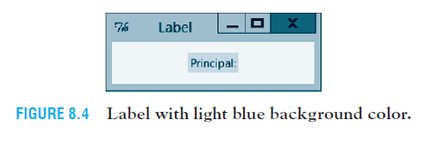
The Label Widget
By default, Label widget has same background color as the window itself
  Label is just wide enough to accommodate its caption
  If we use bg=“light blue" in constructor, then actual width of label revealed
  See Fig. 8.4. Although Labels have a width attribute, it is never needed in the programs we will write.

Slide 21
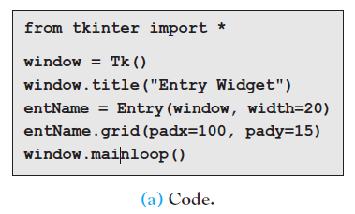
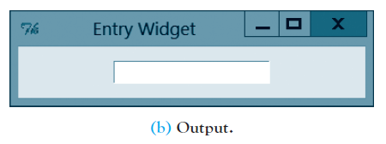
The Entry Widget
The Entry widget is used both to obtain input from the user and to display output.
  The code in Fig(a) produces the output in Fig (b).
Run the program in (a) and then left-click on the Entry widget to place the cursor inside the widget. You can now type any characters into the Entry box.
  Since the width was set to 20 characters in the constructor, if you type more than 20 characters your text will scroll to the left.
  You can use many features that are common to word processors. For instance, you can double-click on a word to select it and then use the Delete key to remove it,
  or use Ctrl+C to place the word in the clipboard. You can also use the Home, End, Insert, and Backspace keys as you would with any word processor. However, you cannot use Ctrl+B to bold text or Ctrl+I to italicize text.

Slide 22
The Entry Widget
Unlike Button widgets, Entry widgets do not have a command argument that binds it to a callback function that is called when a certain event is triggered.
However, the bind method can be used with Entry widgets to play that role. For instance, a line of code of the form:
nameOfEntryWidget.bind("", functionName)
calls the named function when the Entry widget is clicked on with the right mouse button.
Note: In this situation, the named function must contain a parameter. We will give the parameter the name: event

Slide 23
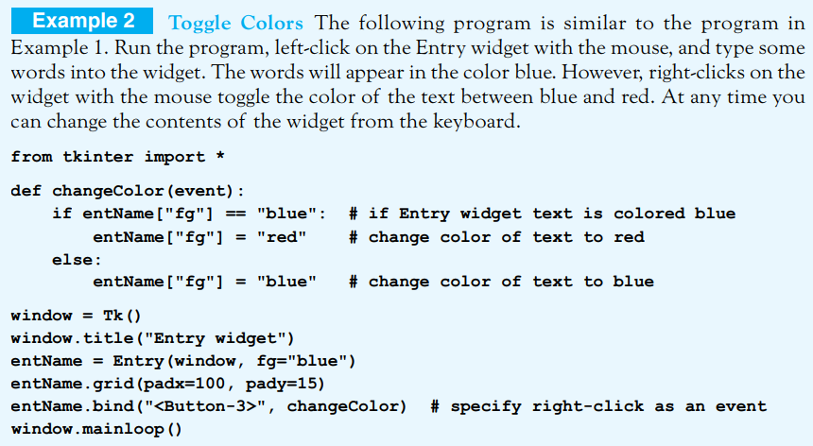
The Entry Widget

Slide 24
The Entry Widget
The standard way of retrieving data from an Entry widget is to first create a string variable with a statement of the form
variableName = StringVar()
and insert the argument textvariable=variableName into the Entry’s constructor. After that, the value of
variableName.get()
will be a string consisting of the data in the Entry widget, and a statement of the form
variableName.set(aValue)
will place the specified string or numeric value into the Entry widget.
In our examples, variableName will have the form conOFentEntryName, an abbreviation of ‘contents of the named Entry widget’.

Slide 25
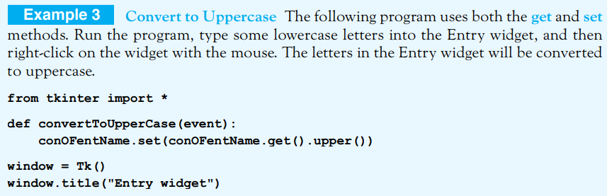
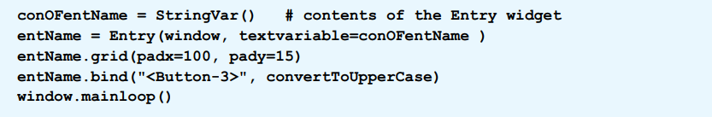
The Entry Widget
© 2016 Pearson Education, Ltd. All rights reserved.

Slide 26
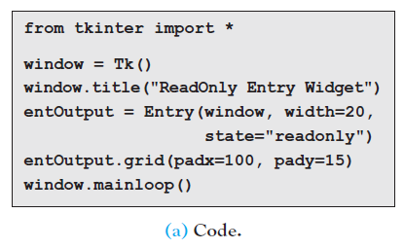
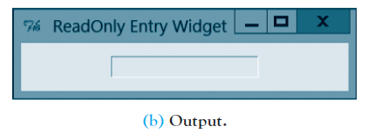
The ReadOnly Entry Widget
The ReadOnly Entry widget is a special type of Entry widget that is used only to display output.
  The code in (a) produces the output in (b).
  ReadOnly Entry widget is specified by adding the argument state="readonly" to the constructor of an ordinary Entry widget.

Slide 27
The ReadOnly Entry Widget
Run the program in (a) and notice that the box is not white. Left-click on the Entry widget. Nothing happens; the cursor does not appear in the widget, and therefore you cannot type any text into the widget.
The only way to display text in a ReadOnly widget is to insert a textvariable attribute into the constructor and modify the attribute’s contents using the set method.

Slide 28
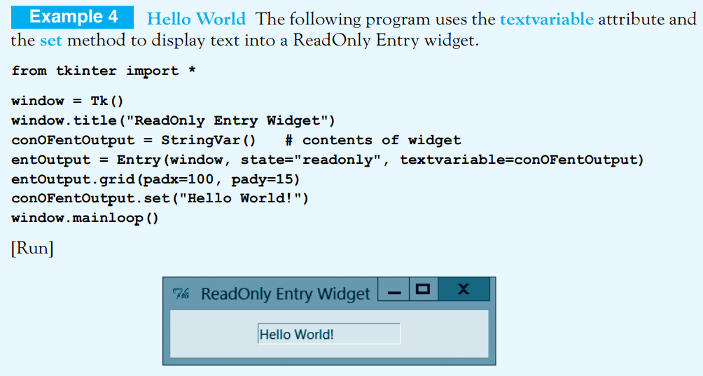
The ReadOnly Entry Widget

Slide 29
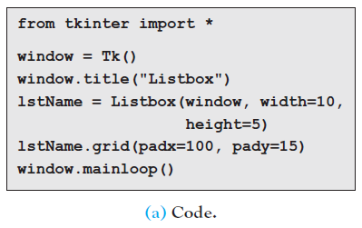
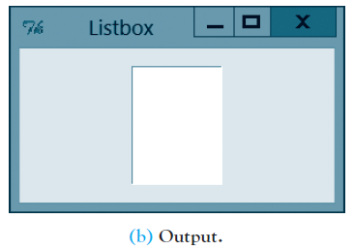
The Listbox Widget
The Listbox widget is primarily used to select from a list of items displayed in a vertical rectangular box.
However, it also can be used to display data generated by the program.
  The code in (a) produces the output in (b). The height attribute specifies the number of lines that can appear in the list box at one time, default value of height is 10
  and the width attribute specifies the number of characters that can appear in each line, default value of width is 20

Slide 30
The Listbox Widget
Code places data into and retrieves data from a Listbox widget in a way similar to that of an Entry widget. The statement that instantiates the Listbox widget is proceeded with a statement of the form
variableName = StringVar()
However, the Entry attribute textvariable in the constructor is replaced with the Listbox attribute listvariable.
To place items into a list box, first create a list (call it L) containing the items and then execute a statement of the form
variableName.set(tuple(L))

Slide 31
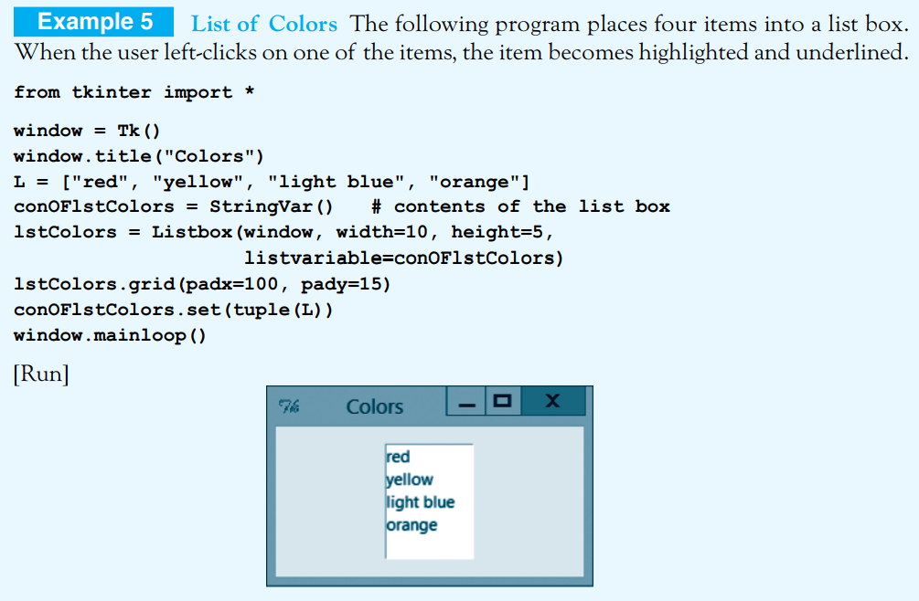
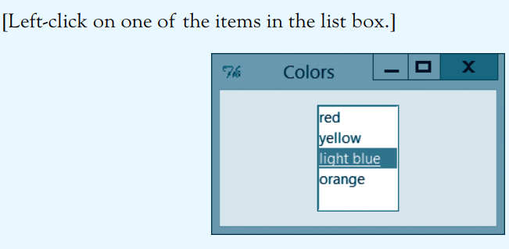
The Listbox Widget

Slide 32
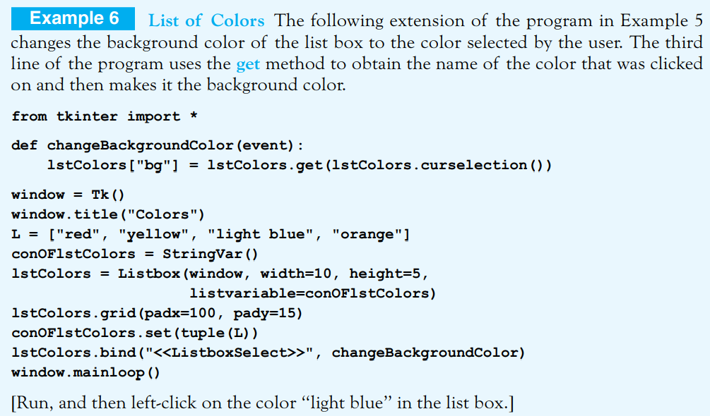
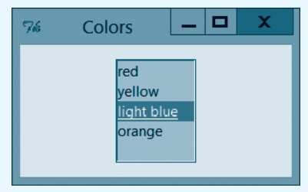
When the user left-clicks on an item in a list box, the event <> is triggered and the value of the item (a string) is returned by an expression of the form
listboxName.get(listboxName.curselection())
where the curselection method identifies the selected item.

Slide 33
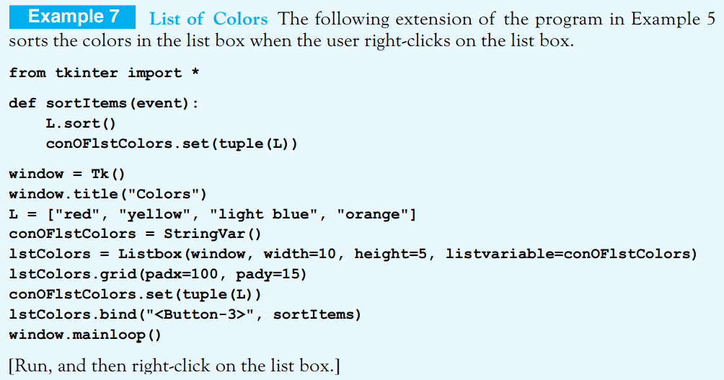
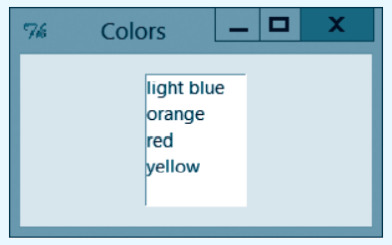
To change the contents of a list box, use list methods to change the list L and then execute the set method. For instance, you can use the sort method to order the items in the list box.
Note: The height (h) of a list box specifies that it can display only h items at a time. If you use a list containing more than h items to fill the list box, only the first h items will be visible initially. However, you can press the Tab key and then use the Page Down/Up keys, the DownArrow/UpArrow keys, or the scroll wheel on the mouse to scroll through the box

Slide 34
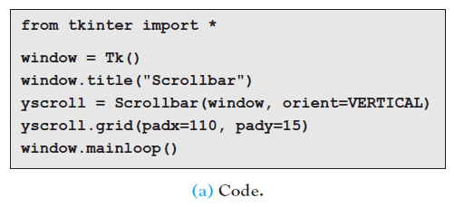
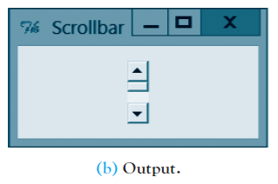
The Scrollbar Widget
The code in (a) produces the output in (b).
Vertical scroll bars can be connected to list boxes containing long lists to allow the user to move up and down through the items. Scrolling takes place when the user clicks on one of the arrows or drags the small raised-looking rectangle located between the two arrows.
The process of connecting a vertical scroll bar to a list is covered in next section since it requires an understanding of the details of the grid geometry manager

Slide 35
End
Section 1
Chapter 8
© 2016 Pearson Education, Ltd. All rights reserved.

